Slide 1
Dog Breed Identification

Slide 2
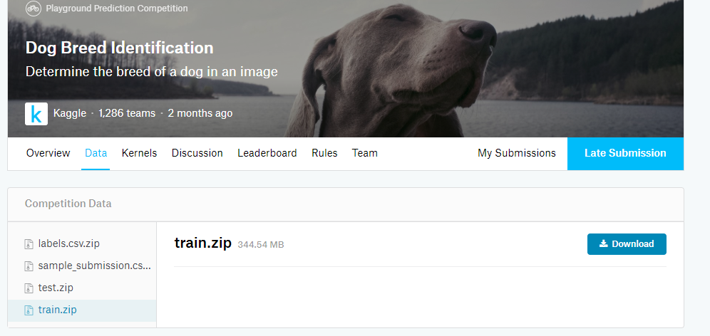
website
https://www.kaggle.com/c/dog-breed-identification/data

Slide 3
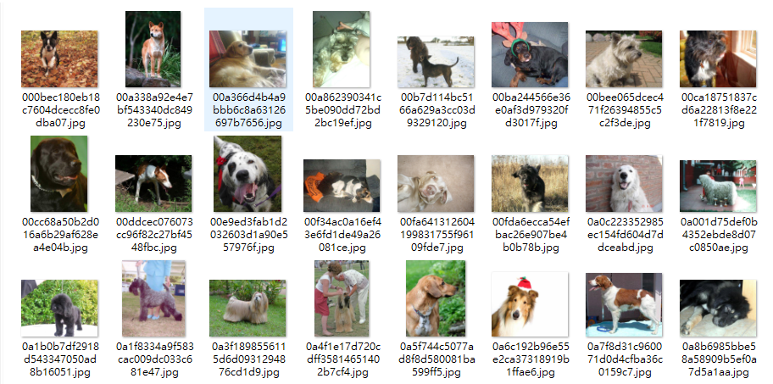
data
Train:10222
Test:10357

Slide 4
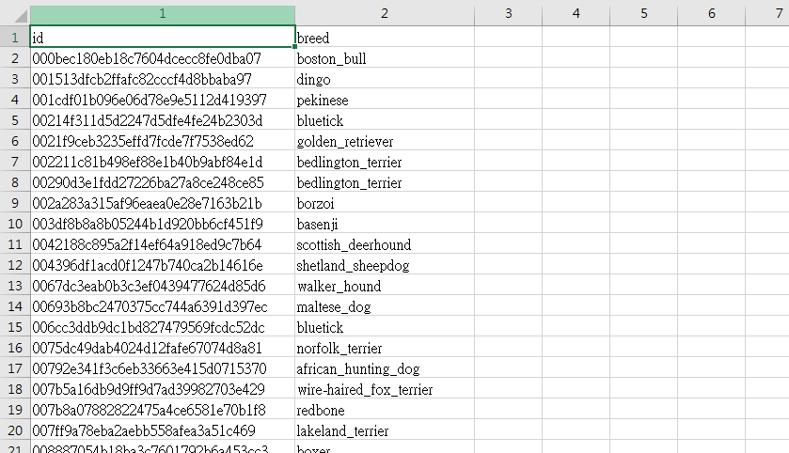
classification
Classification:120
labels.csv : id(image),breed(label)

Slide 5
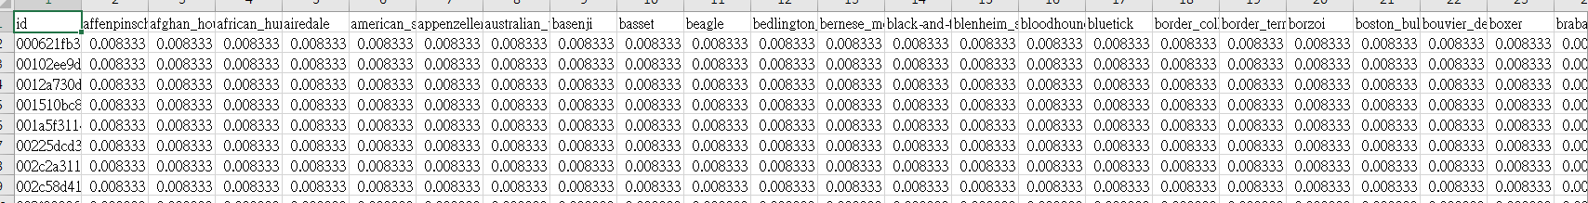
Upload sample
該張圖片對應到120個label的機率
sample_submission.csv

